Slide 1
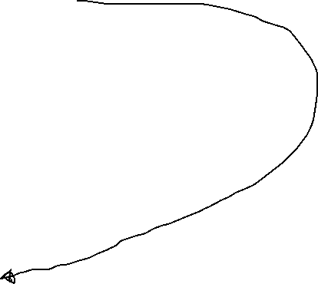
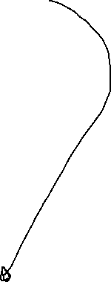
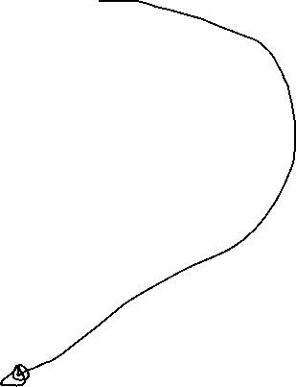
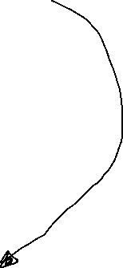
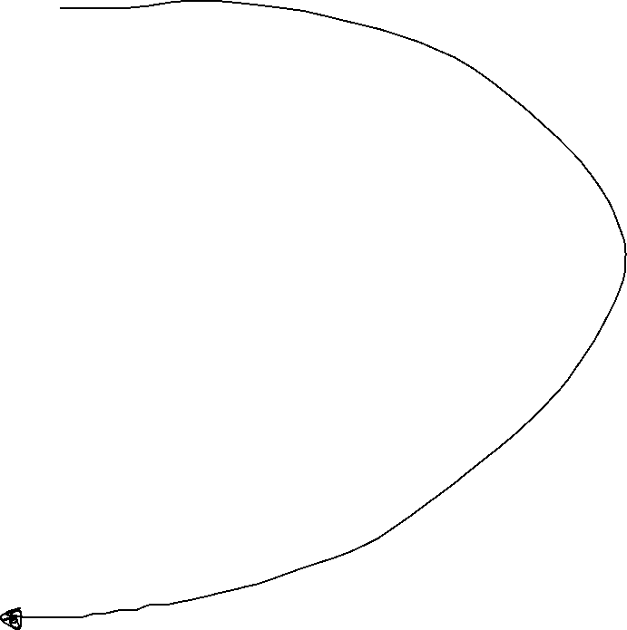
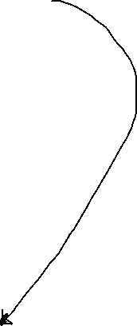
q
•
4 bytes
p
•
4 bytes
what
guard
•
4 bytes
min
•
4 bytes
max
•
4 bytes
n
6
8 bytes
a*
•
8 bytes
Y[5]
3
Y[4]
0
Y[3]
2
Y[2]
100
48 bytes
Y[1]
0
Y[0]
1
X[5]
0
X[4]
0
x[3]
-99
X[2]
0
48 bytes
X[1]
0
AR Main
X[0]
99
w
3
8 bytes
No Args
8 bytes

